Slide 1

INPLANT TRAINING PRESENTATION
By,
Anirudh V Veliyur
20CHE191
Guide:- Prof. ABP

Slide 2
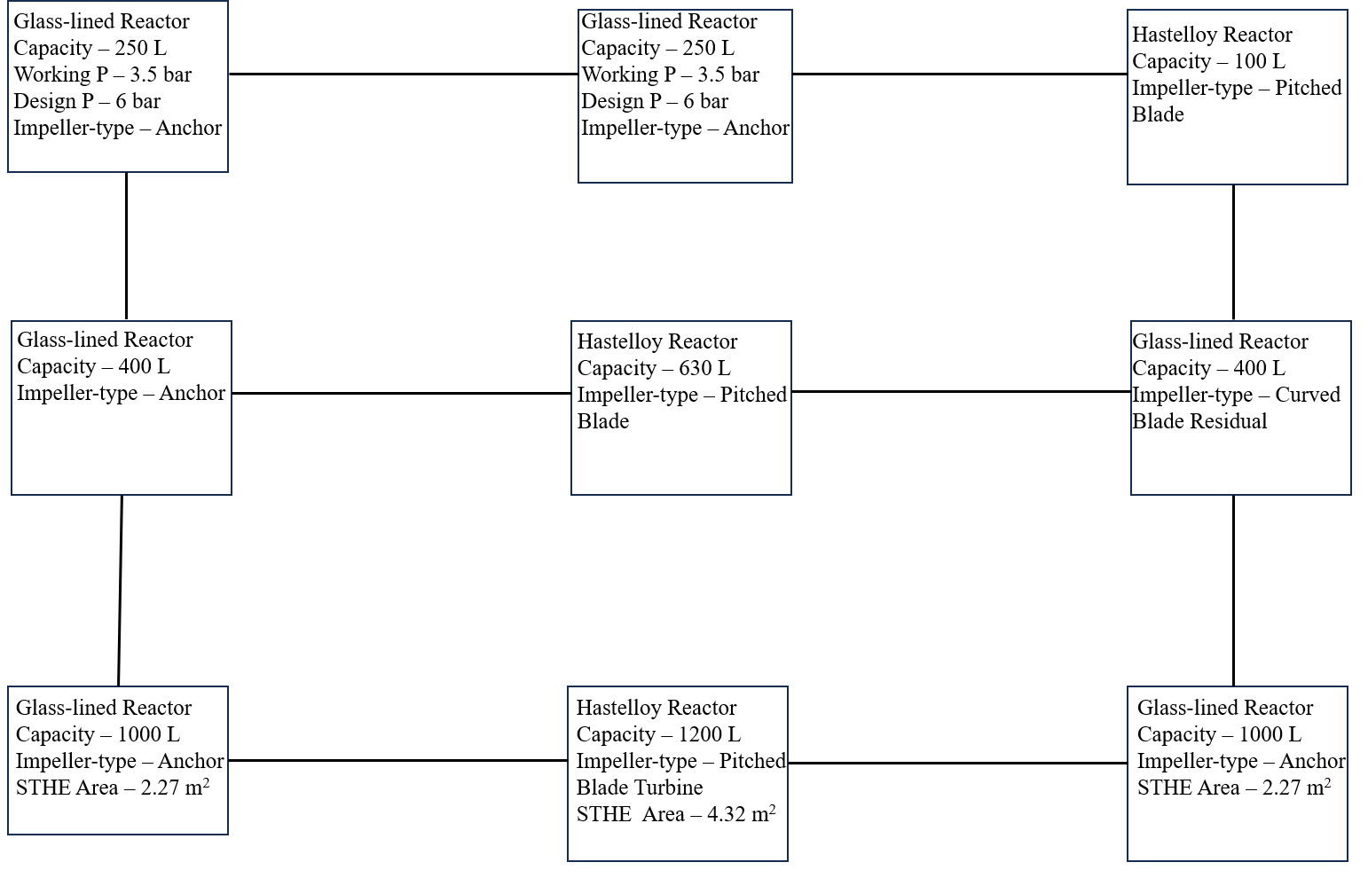
Process Area

Slide 3
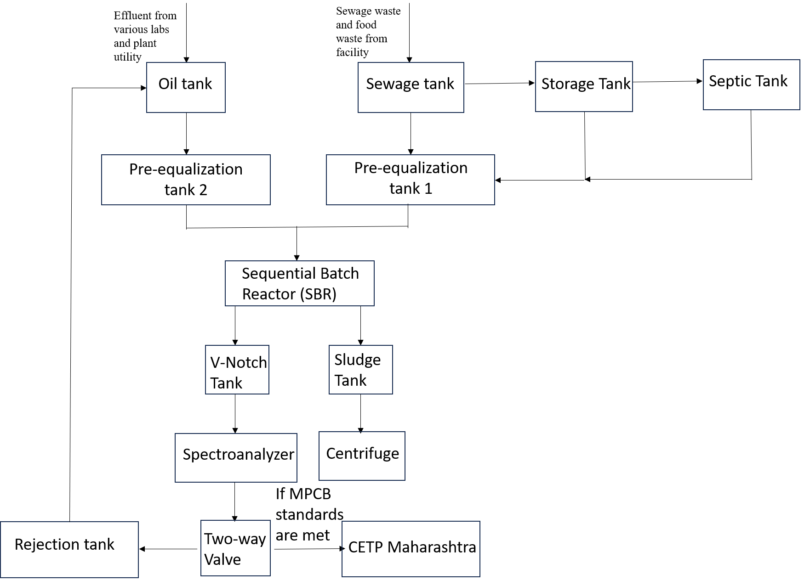
EFFLUENT TREATMENT PLANT

Slide 4
SOP for Process Development in Flow Reactors

Slide 5
BATCH
VS
FLOW

Slide 6
Identify target reaction, collect literature on similar reactions.**
Safety assessment for batch
NOT SAFE
SAFE
Does literature provide conditions that suit project’s needs in batch?
Yield 3) Scale
Reaction time
NO
Is the immediate goal to optimize discrete variables?(Solvent, Catalyst, Ligand, Reagents)
NO
YES
YES
Type of multiphasic system
GAS-LIQ
SOL-GAS
LIQ-LIQ
SOL-LIQ
SOL-LIQ-GAS
Does a precipitate drive equilibrium in the desired direction?
YES
Are highly homogenous emulsions required?
Does the reaction involve insoluble suspensions?
NO
NO
YES
NO
YES
NO
Are heterogenous catalysts involved?
YES
NO
Notes:
**
For new transformations, it is more convenient to screen reagents, solvents, and additives in batch.
When there is minimal quantity of reagent, flow is preferred as small volume chip reactors enable chemists to analyse a large number of reactions.

Slide 7
Is the reaction fast?
YES
NO
YES
Is selectivity affected by temperature?
NO
YES
Does heating speed up the reaction?*
YES
NO
Is reaction photochemically or electrochemically driven?
NO
References:-
Plutschack MB, Pieber B, Gilmore K, Seeberger PH. The Hitchhiker's Guide to Flow Chemistry ∥. Chem Rev. 2017 Sep 27;117(18):11796-11893. doi: 10.1021/acs.chemrev.7b00183. Epub 2017 Jun 1. PMID: 28570059.
Wegner, J.; Ceylan, S.; Kirschning, A. Flow Chemistry − A Key Enabling Technology for (Multistep) Organic Synthesis. Adv. Synth.
Catal. 2012, 354, 17−57.
3) Irfan, M.; Glasnov, T. N.; Kappe, C. O. Heterogeneous Catalytic Hydrogenation Reactions in Continuous-Flow Reactors. ChemSusChem 2011, 4, 300−316.
Notes:
*If the reaction time of the target reaction is less than 48 hours at room temperature, it can be heated and performed in a batch reactor at up to 80°C. If it is greater than 48 hours, a flow reactor is preferred as temperatures above 80°C would be required.

Slide 8
Disclaimer:
This study is from a purely academic point of view of whether to go for batch or continuous processes. After the decision is made to go in flow or batch is made, there needs to be an analysis of processes and subprocesses involved before making a decision for the commercial level. Then, a flow diagram with specific choices of equipment will have to be made following which a thorough cost analysis is done.
If there is a largely prohibitive cost associated with the given manufacturing process decision, then, the decision loop goes back to the first step where another synthesis route is identified for the given product and literature is studied.
If, on the other hand, the margins are less, then it can be improved by trying to change the type of subprocesses or the choice of equipment used.

Slide 9
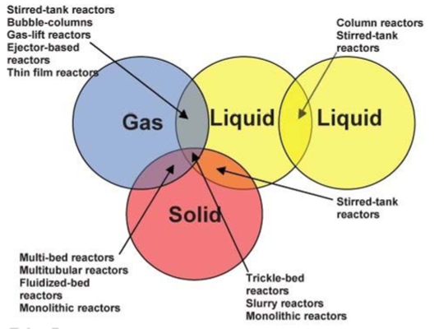
Selection of Conventional flow reactors
Reference:-
CHEMICAL ENGINEERING AND CHEMICAL PROCESS TECHNOLOGY – Vol. III - Multiphase Reactors - A. Stankiewicz

Slide 10
CLASSIFICATION & SELECTION OF MICROSTRUCTURED REACTORS

Slide 11
Fluid-Fluid
Solid-Fluid/3-Phase
Micromixers
Micromixer+Microchannel
Continuous
Dispersed
Micromixer-settler
Cyclone Mixer
Interdigital mixer
Falling film
Mesh reactors
Microbubble
Micropacked
With partial two-fluid contact
Mesh or sievelike interfacial support
With T and Y type inlet contactors
With static mixers
With internal redispersion units
Falling film reactors
Reference:-
Kashid, Madhvanand N.; Kiwi-Minsker, Lioubov (2009). Microstructured Reactors for Multiphase Reactions: State of the Art. Industrial & Engineering Chemistry Research, 48(14), 6465–6485. doi:10.1021/ie8017912
Jähnisch, K., Hessel, V., Löwe, H., & Baerns, M. (2004). Chemistry in Microstructured Reactors. In Angewandte Chemie - International Edition (Vol. 43, Issue 4, pp. 406–446). https://doi.org/10.1002/anie.200300577

Slide 12
Gas-Liquid
Liquid-Liquid
Micromixer + Microchannel
Halogenation
Oxidation
Sulfonation
Nitration
Miscible
Immiscible
Falling film reactor
Microbubble column
Falling film reactor
Continuous flow film
Falling film reactor
Falling film reactor
Interdigital mixer + Microchannel with split and recombine
Multilamination interdigital mixer
Microchannels with T and Y type inlet contactors
Microchannels with static mixers
Parallel microchannels with internal redispersion units.
Interdigital mixer + Microchannel with split and recombine
Impinging Jet Mixer
Glass cyclone mixer
Solid-Fluid/3-Phase
Micropacked bed
Mesh
Reference:-
Kashid, Madhvanand N.; Kiwi-Minsker, Lioubov (2009). Microstructured Reactors for Multiphase Reactions: State of the Art. Industrial & Engineering Chemistry Research, 48(14), 6465–6485. doi:10.1021/ie8017912
Jähnisch, K., Hessel, V., Löwe, H., & Baerns, M. (2004). Chemistry in Microstructured Reactors. In Angewandte Chemie - International Edition (Vol. 43, Issue 4, pp. 406–446). https://doi.org/10.1002/anie.200300577
Falling film
Membrane

Slide 13
One of the major problems encountered in the industry is versatility of reactors for various chemistries. In this aspect, the batch type of operation of a conventional stirred tank reactor proves to be most versatile even though it has less-efficient mass transfer capacity and is tedious in multi-step processing.
However, with the advent of modular microstructure reactors manufactured by Lonza, Corning and many other upcoming companies, this gap in versatility of application of MSR technology in commercial-scale synthesis is continuously being bridged.

Slide 14
Step-wise strategy for process development in flow reactors
Physical properties of reagents, catalysts, mobile phases and products
Solubility studies
Reaction kinetics
Side reaction studies
Reaction enthalpy
Geometry and MOC of reactor material and heat transfer fluid properties.
Pressure drop characterization
Characterization of heat transfer behavior
Characterization of mass transfer behavior
Development of a dynamic process model
Strategy for Process development and scale-up
Validation of experimental results with dynamic process model
Scale-up

Slide 15
STEP-1: Physical properties
Density
Heat capacity
Thermal conductivity
Viscosity
Molar mass
These are some of the major physical properties that must be determined from literature or from experimentation
Considering known physical properties and neglecting the influence of the other components represent a first approximation if no further measurements are possible.
Sources of Data:
Robert H Perry, Perry’s Chemical Engineers’ Handbook, 8th Edition, McGraw-Hill, New York, Section 2, 2008.
NIST Webbook.
Bruce E Poling, The Properties of Gases and Liquids, 5th Edition, McGraw-Hill, New York, Chapters 5, 9 & 10, 2001.
Bair, S. (2013). Temperature and Pressure Dependence of Density and Thermal Conductivity of Liquids. Encyclopedia of Tribology, 3527–3533. doi:10.1007/978-0-387-92897-5_596.

Slide 16
Step-2: Solubility studies
Firstly, existing data is gathered on the target system in literature. If there is no data available, then experiments must be performed.
The saturation shake-flask method is preferred to evaluate whether the solid product is soluble in a mixture of the reagent fluids. This is because predictive methods are scarce for non-aqueous systems and for mixtures of organic reagents. Hence, experimental method(SSF) is best suited.
We put a fixed amount of product in a fixed amount of reagent mixture and check for solubility by varying 3 major parameters, T, P and pH. We obtain profiles of solubility versus T, P and pH with which we can determine limits on process conditions or necessary product removal strategies.
Experimental data can be used to create correlations. Experimental data is a necessity as predictive models only provide a very crude estimate which has to evaluated. Also, these predictive methods can only serve as an initial guess in different calculations.
References:-
Bruce E Poling, The Properties of Gases and Liquids, 5th Edition, McGraw-Hill, New York, Chapter 8, 2001.
Stanley I Sandler, Chemical, Biochemical and Engineering Thermodynamics, 5th Edition, John Wiley & Sons, New Jersey, Chapter 11, 2017
IUPAC NIST Solubility data series

Slide 17

Step-3: chemical kinetics
The experimental strategy of obtaining rate equation is the most reliable way as predictive methods are insufficient and prone to error. These steps can be performed simultaneously with the subsequent enthalpy and T rise determination steps in a Reaction Calorimeter.
There are 3 crucial aspects of any reaction that would be required to model it:-
1) Stoichiometry
2) Kinetics
3) Model
All 3 are interdependent and when we have no data about the model, we can only fit the kinetic data with a crude model of
This would help us in setting up the dynamic process model and to find reaction time.
However, independent contributions due to different concentrations need to be ascertained to find which reactant's influence on reaction rate is highest. This is crucial for optimisation strategies for reaction time.
Impact of temperature on the temperature-dependent term and activation energy must also be determined to determine reaction time at different temperatures.
References:-
Octave Levenspiel, Chemical Reaction Engineering,3rd Edition, John Wiley & Sons, New York , Chapter 2 & 3, 1999
Himmelblau, D. M.; Jones, C. R.; Bischoff, K. B. (1967). Determination of Rate Constants for Complex Kinetics Models. Industrial & Engineering Chemistry Fundamentals, 6(4), 539–543. doi:10.1021/i160024a008
https://www.princeton.edu/~rpl/Labs/spring/ic_temp.html#:~:text=This%20is%20an%20equation%20for,y%2Dintercept%20of%20ln%20A.

Slide 18
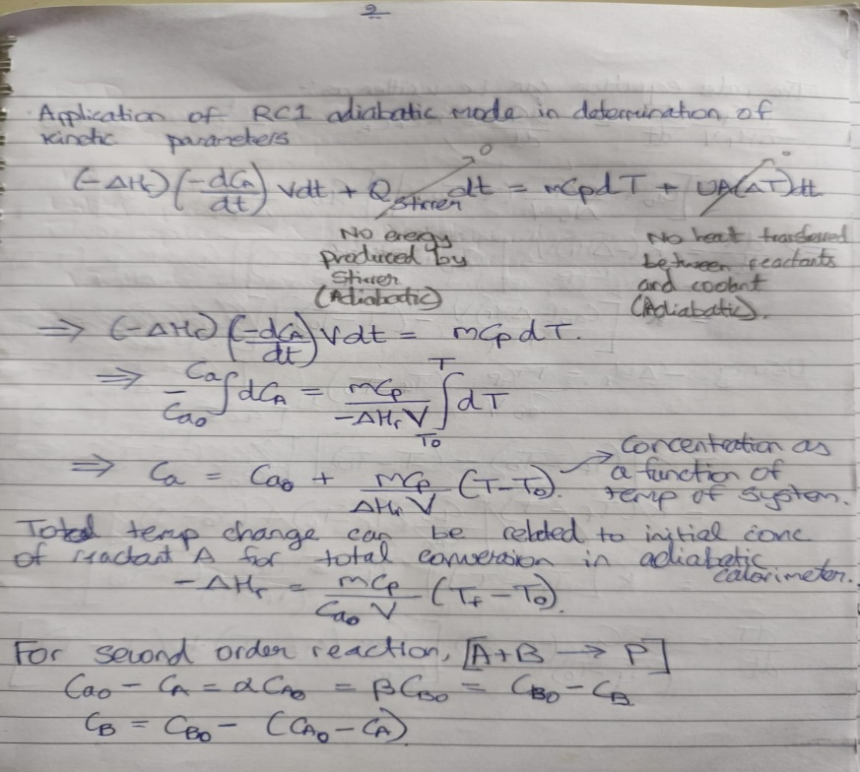
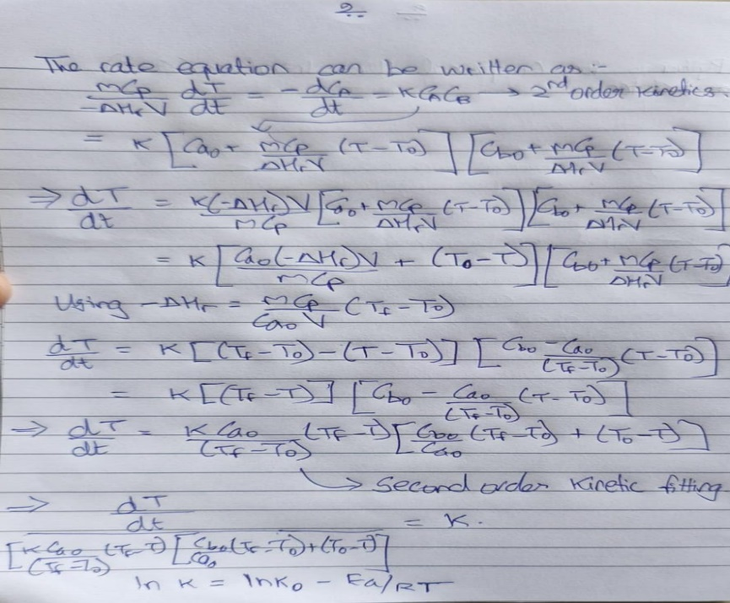
Step-3: chemical kinetics
Energy balance
Second order equation

Slide 19
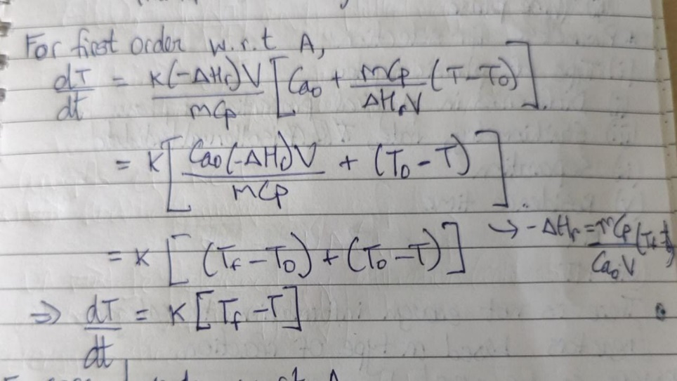
Step-3: chemical kinetics
First order equation

Slide 20
STEP-4: Enthalpy and t rise
The data obtained from ARC shows the total thermal potential when the reaction cannot be controlled resulting in more heat and a higher temperature rise. This information is primarily required for safety screening and not for reaction characterization.
The data obtained from RC shows the thermal potential when the reaction is controlled. This information is required for reaction characterization and dynamic process modelling of thermal and concentration profile of the process.
A theoretical way of predicting heat of reaction is to multiply and add up all the bond energies to break different bonds in products side and subtract it with reactants side and determine the enthalpy of reaction.
References:-
https://www.fauske.com/blog/calculating-heat-of-reaction-from-adiabatic-calorimetry-data
Jyotsna, G. K., Srikanth, S., Ratnaparkhi, V., Rakeshwar, B. (2017). Reaction calorimetry as a tool for thermal risk assessment and improvement of safe scalable chemical processes. Inorg Chem Ind J.,12(1),110.
https://www.pharmacalculations.com/2017/07/bond-energy-calculations.html

Slide 21
STEP-5: Side reaction studies
Competitive reactions such as consecutive or parallel reactions lead to side product formation, which lowers the yield and may complicate work-up processes. Hence, these side reactions must be studied and their influence on desired reaction should be evaluated.
This would give us a picture of impurity profile and work-up or separation procedures involved.
The data obtained from ARC shows the total thermal potential when the reaction cannot be controlled resulting in more heat and a higher temperature rise due to these side reactions. This information is primarily required for safety screening and not for reaction characterization.
Sources:-
1) Florencio Zaragoza Dorwald, Side Reactions in Organic Synthesis – A Guide to Successful Synthesis Design, Wiley-VCH, 2005

Slide 22
STEP-6: Reactor information

Slide 23
STEP-7: Pressure drop characterization
The predictive correlations used involving Lockhart-Martinelli and Chisholm method are subject to errors because they do not provide correlations for dimensions of microchannels.
Friction factors in microchannels must be characterized experimentally. In absence of experiments, these correlations can be used to give a very crude idea but these cannot substitute actual characterization.
Procedure for characterization and predictive method are provided in Excel.
References:-
1) Kazi, M. Salim Newaz (2012). An Overview of Heat Transfer Phenomena || Two-Phase Flow. , 10.5772/2623(Chapter 11), –. doi:10.5772/54291
2) N. Kockmann (2008). Pressure Loss and Transfer Rates in Microstructured Devices with Chemical Reactions. , 31(8), 1188–1195. doi:10.1002/ceat.200800065
3) Nieves-Remacha, Maria Jose, Amol A. Kulkarni, and Klavs F.
Jensen. “Gas–Liquid Flow and Mass Transfer in an Advanced-Flow
Reactor.” Ind. Eng. Chem. Res. 52, no. 26 (July 3, 2013): 8996–9010.
4) Norbert Kockmann, Transport Phenomena in Micro Process Engineering, Springer Berlin Heidelberg New York, Chapter 3, Page 89, 2008
5) Frank. M. White, Fluid Mechanics, 7th Edition, McGraw-Hill, New York, Chapter 6, 2011

Slide 24
STEP-8: Heat transfer characterization
Step-1: Biot Number determination
Step-2: ATR determination
Step-3: β determination
Step-4: U determination
Step-5: Cooling fluid temperature determination
References:-
1) Zhang, Jisong; Wang, Kai; Teixeira, Andrew R.; Jensen, Klavs F.; Luo, Guangsheng (2017). Design and Scaling Up of Microchemical Systems: A Review. Annual Review of Chemical and Biomolecular Engineering, 8(1), annurev-chembioeng-060816-101443–. doi:10.1146/annurev-chembioeng-060816-101443
2) Norbert Kockmann; Michael Gottsponer; Dominique M. Roberge (2011). Scale-up concept of single-channel microreactors from process development to industrial production. , 167(2-3), 718–726. doi:10.1016/j.cej.2010.08.089
3) Norbert Kockmann; Dominique M. Roberge (2011). Scale-up concept for modular microstructured reactors based on mixing, heat transfer, and reactor safety. , 50(10), 1017–1026. doi:10.1016/j.cep.2011.05.021
The correlations used involving Nu number are all purely predictive and subject to errors. Heat transfer coefficients in flow reactors must be characterized experimentally. In absence of experiments, these correlations can be used to give a very crude idea but these cannot substitute actual characterization.

Slide 25
STEP-9: Mass transfer characterization
Step-1: Mixing time approximation
Step-2: Mass transfer coefficient
References:-
1) Zhang, Jisong; Wang, Kai; Teixeira, Andrew R.; Jensen, Klavs F.; Luo, Guangsheng (2017). Design and Scaling Up of Microchemical Systems: A Review. Annual Review of Chemical and Biomolecular Engineering, 8(1), annurev-chembioeng-060816-101443–. doi:10.1146/annurev-chembioeng-060816-101443
2) Norbert Kockmann; Michael Gottsponer; Dominique M. Roberge (2011). Scale-up concept of single-channel microreactors from process development to industrial production. , 167(2-3), 718–726. doi:10.1016/j.cej.2010.08.089
3) Norbert Kockmann; Dominique M. Roberge (2011). Scale-up concept for modular microstructured reactors based on mixing, heat transfer, and reactor safety. , 50(10), 1017–1026. doi:10.1016/j.cep.2011.05.021
4) Sitaraman, Ramalingam; Ibrahim, S. H.; Kuloor, N. R. (1963). A Generalized Equation for Diffusion in Liquids.. Journal of Chemical & Engineering Data, 8(2), 198–201. doi:10.1021/je60017a017
5) DÍAZ, MARIO; VEGA, AURELIO; COCA, JOSÉ (1987). CORRELATION FOR THE ESTIMATION OF GAS-LIQUID DIFFUSIVITY. Chemical Engineering Communications, 52(4-6), 271–281. doi:10.1080/00986448708911872
6) O. Barlay Ergu; O.N. Sara; S. Yapıcı; M.E. Arzutug (2009). Pressure drop and point mass transfer in a rectangular microchannel. , 36(6), 618–623. doi:10.1016/j.icheatmasstransfer.2009.03.015
7) Nieves-Remacha, Maria Jose, Amol A. Kulkarni, and Klavs F. Jensen. “Gas–Liquid Flow and Mass Transfer in an Advanced-Flow Reactor.” Ind. Eng. Chem. Res. 52, no. 26 (July 3, 2013): 8996–9010.
The correlations used involving Sc number are all purely predictive and subject to errors. Mass transfer coefficients in flow reactors must be characterized experimentally. In absence of experiments, these correlations can be used to give a very crude idea but these cannot substitute actual characterization.

Slide 26
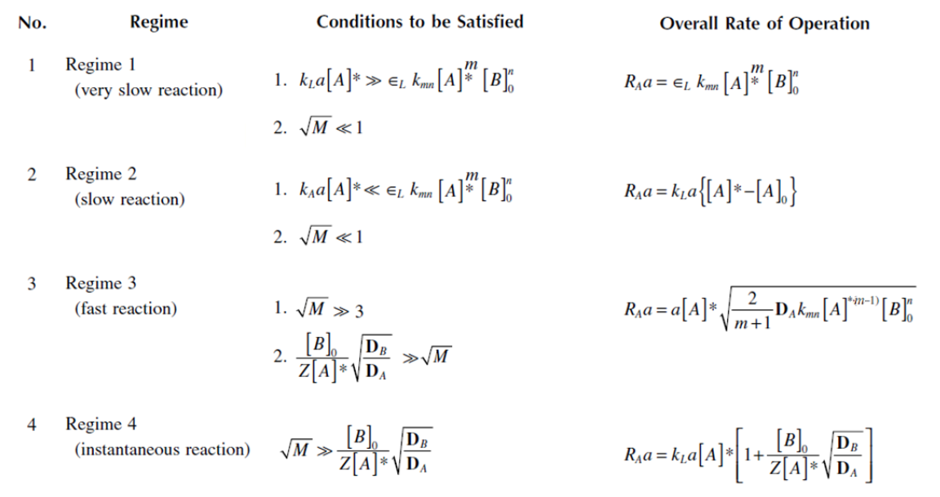
STEP-10: Process development strategies
Damkohler number
Hatta number
Da<1, kinetic reaction-limited system
Da>1, Mass transfer-controlled system
References:-
1) S. Hatta, Technological Reports of Tôhoku University, 10, 613-622 (1932).
2) Zhang, Jisong; Wang, Kai; Teixeira, Andrew R.; Jensen, Klavs F.; Luo, Guangsheng (2017). Design and Scaling Up of Microchemical Systems: A Review. Annual Review of Chemical and Biomolecular Engineering, 8(1), annurev-chembioeng-060816-101443–. doi:10.1146/annurev-chembioeng-060816-101443

Slide 27
STEP-11: dynamic process model
Simulation of Concentration and Temperature versus length of reactor in python and excel.
This simulation uses ideal PFR and steady state assumptions. It can be used as an initial estimation of T and Ca profiles.

Slide 28
STEP-12: Validation
This step entails the process where results that are simulated are validated through experimental procedures. The variables that have to be validated are:
Heat transfer characteristics
Mass transfer characteristics
Concentration at exit
Temperature at the end of the reaction

Slide 29
STEP-13: SCALE-UP
Parallel numbering-up
Advantages: Hydrodynamics and transfer characteristics intact
Disadvantages: Complex fluid flow distribution and control
Series numbering-up
Advantages: Better flow control, low cost, decrease hot spots in fast, exothermic reactions.
Disadvantages: Technology limited
Suitable dimension enlarging
Advantages: Increase throughput
Disadvantages: Hydrodynamics and transfer characteristics might change

Slide 30
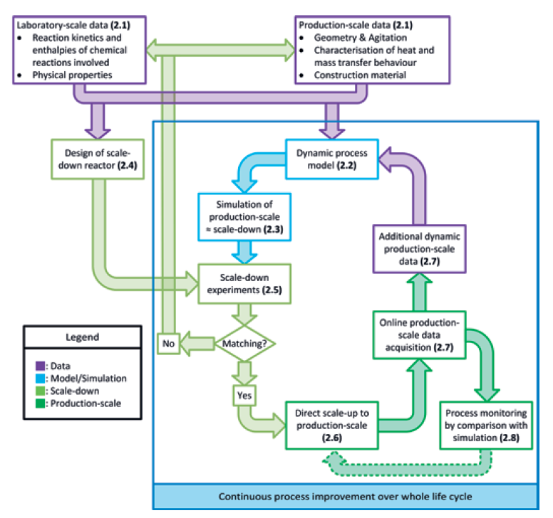

Slide 31
Important points for scale-up
Importance of evaluating whether fast mixing is vital for the designed continuously performed reaction or not. It is, therefore, necessary to be aware of the kinetics of any give transformation in order to properly design a suitable flow setup. In that context, Roberge and co-workers have classified three reaction types where continuous flow processes would be advantageous based on their kinetics.(140)
Mass transfer is often the rate-determining step in this class of reactions, and therefore, such transformations can benefit from micro- or meso-fluidic flow devices. The improved interfacial area is the main reason for doing such transformations in a continuous flow regime.
Use HTE for discrete variables screening and use LabVIEW for continuous variable screening.

Slide 32
Advantages
Continuous, end-to-end manufacturing of products instead of step-by-step batch processes.
Enhanced mass transfer, heat transfer.
Safer
Consumption of energy, raw materials is lesser.
Lesser mixing and reaction times
Higher yield, selectivity and conversion.
High temperature can be employed in enhancing reaction rates without need to use high-boiling solvents which would complicate further separation, by using higher pressure.
Scaling up is easier.

Slide 33
Suggestions
Peristaltic pumps can be used.
Electrokinetic flow techniques can be looked into.
For G-L systems, falling film microreactors and gas permeable membrane reactors can be looked into as tube-in-tube setups have the following disadvantages:- Low gas loading, Insufficient radial mixing, Heating characteristics.
For Solid systems, active mixing techniques must be involved like ultrasonic bath, mechanical agitation, magnetic stirring.
Imprecise residence times can be overcome by using inline analysis techniques in combination with automated collection and/or reagent addition.
Droplet reaction techniques can minimize particle−wall interactions and suppress fouling.
Additionally, “in situ cleaning” via ultrasonication can be used to tackle reactor fouling during a chemical reaction.
Agitated cell reactors can be explored.

Slide 34
Research focus
In-line separation strategies for flow chemistry.
Automation in flow chemistry by developing a logic to simultaneously screen discrete and continuous parameters.
Cheaper pressure regulation in flow.
Nanoparticle catalysts to use in heterogenous, packed-bed systems. Catalysts that are more stable and suitable for continuous processing.
Solving leaching problems in catalysts
Better mixing strategies in flow reactors.
Solubility screening strategies
Faster reaction kinetics determination
Bubble size and number correlation

Slide 35
Separation of 96% n-Heptane and 4% Trifluorotoluene(wt%)

Slide 36
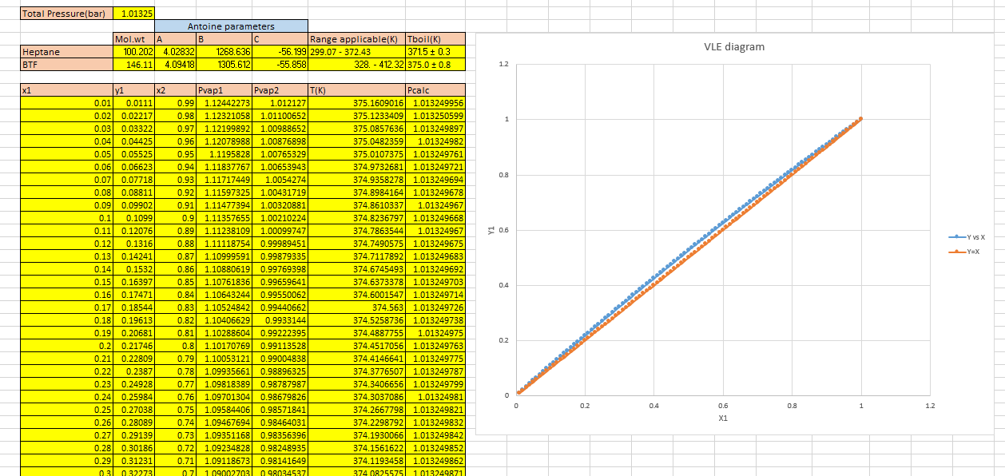
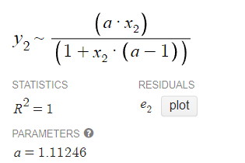
Distillation
α fitting
Ideal VLE data

Slide 37
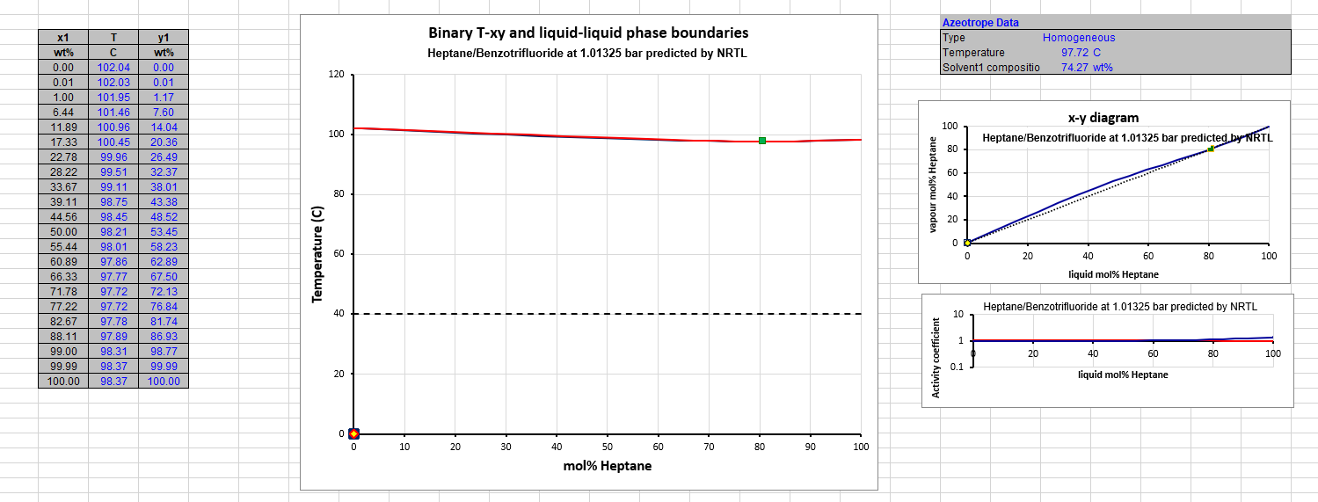
Distillation
Dynochem data

Slide 38
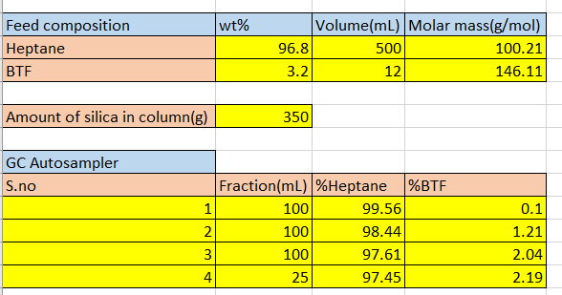
Column chromatography
Chromatography trials

Slide 39
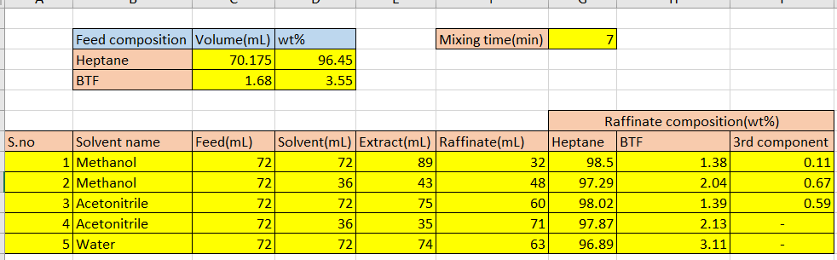
LIQUID-LIQUID EXTRACTION
LLE trials

Slide 40
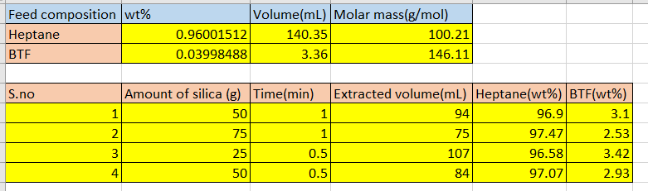
Solid phase extraction
SPE trials

